Slide 1
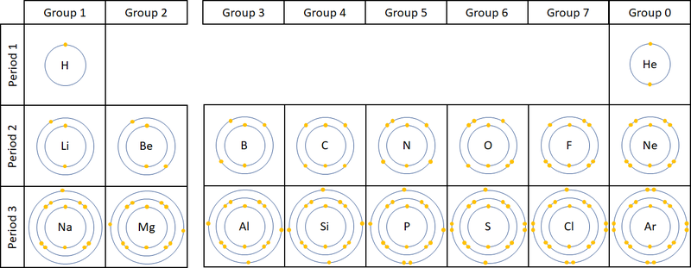
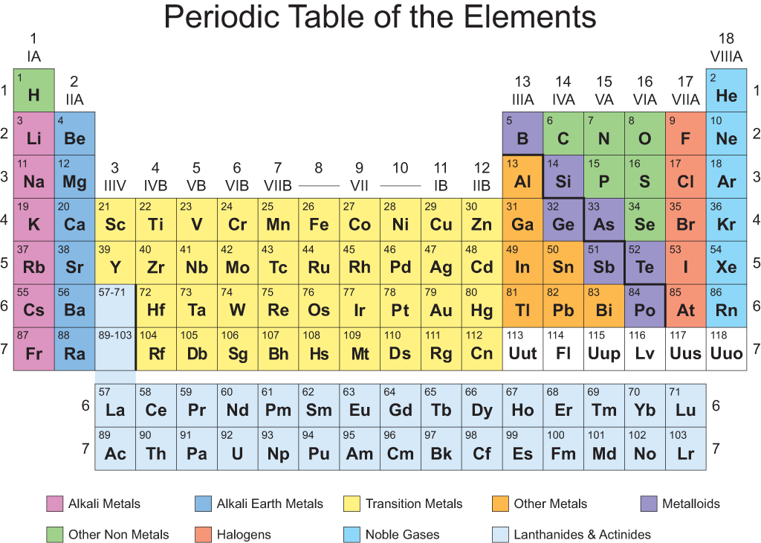
Remember the connection between shells and the Periodic Table

Slide 2
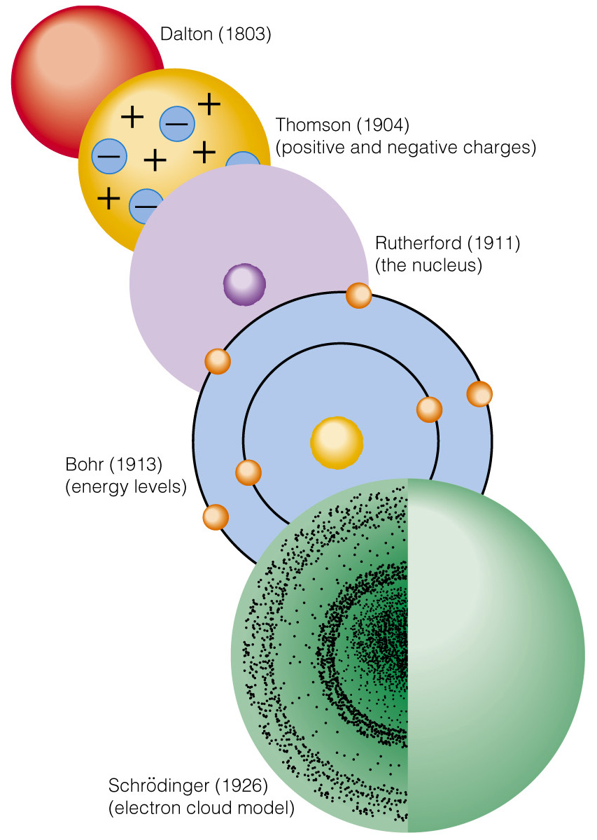
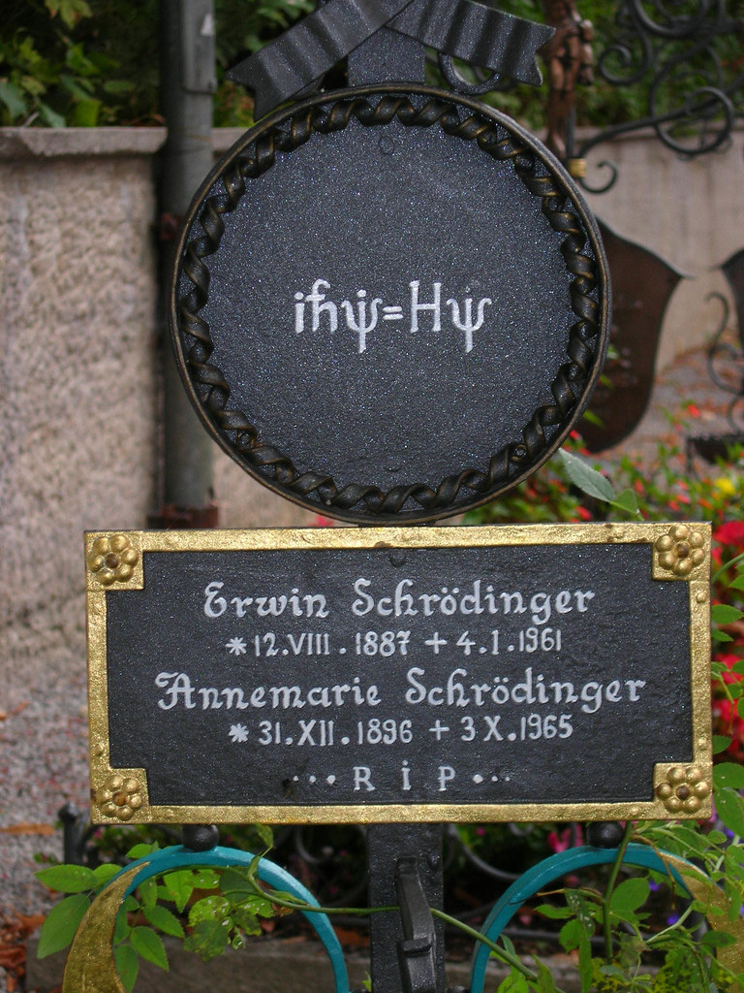
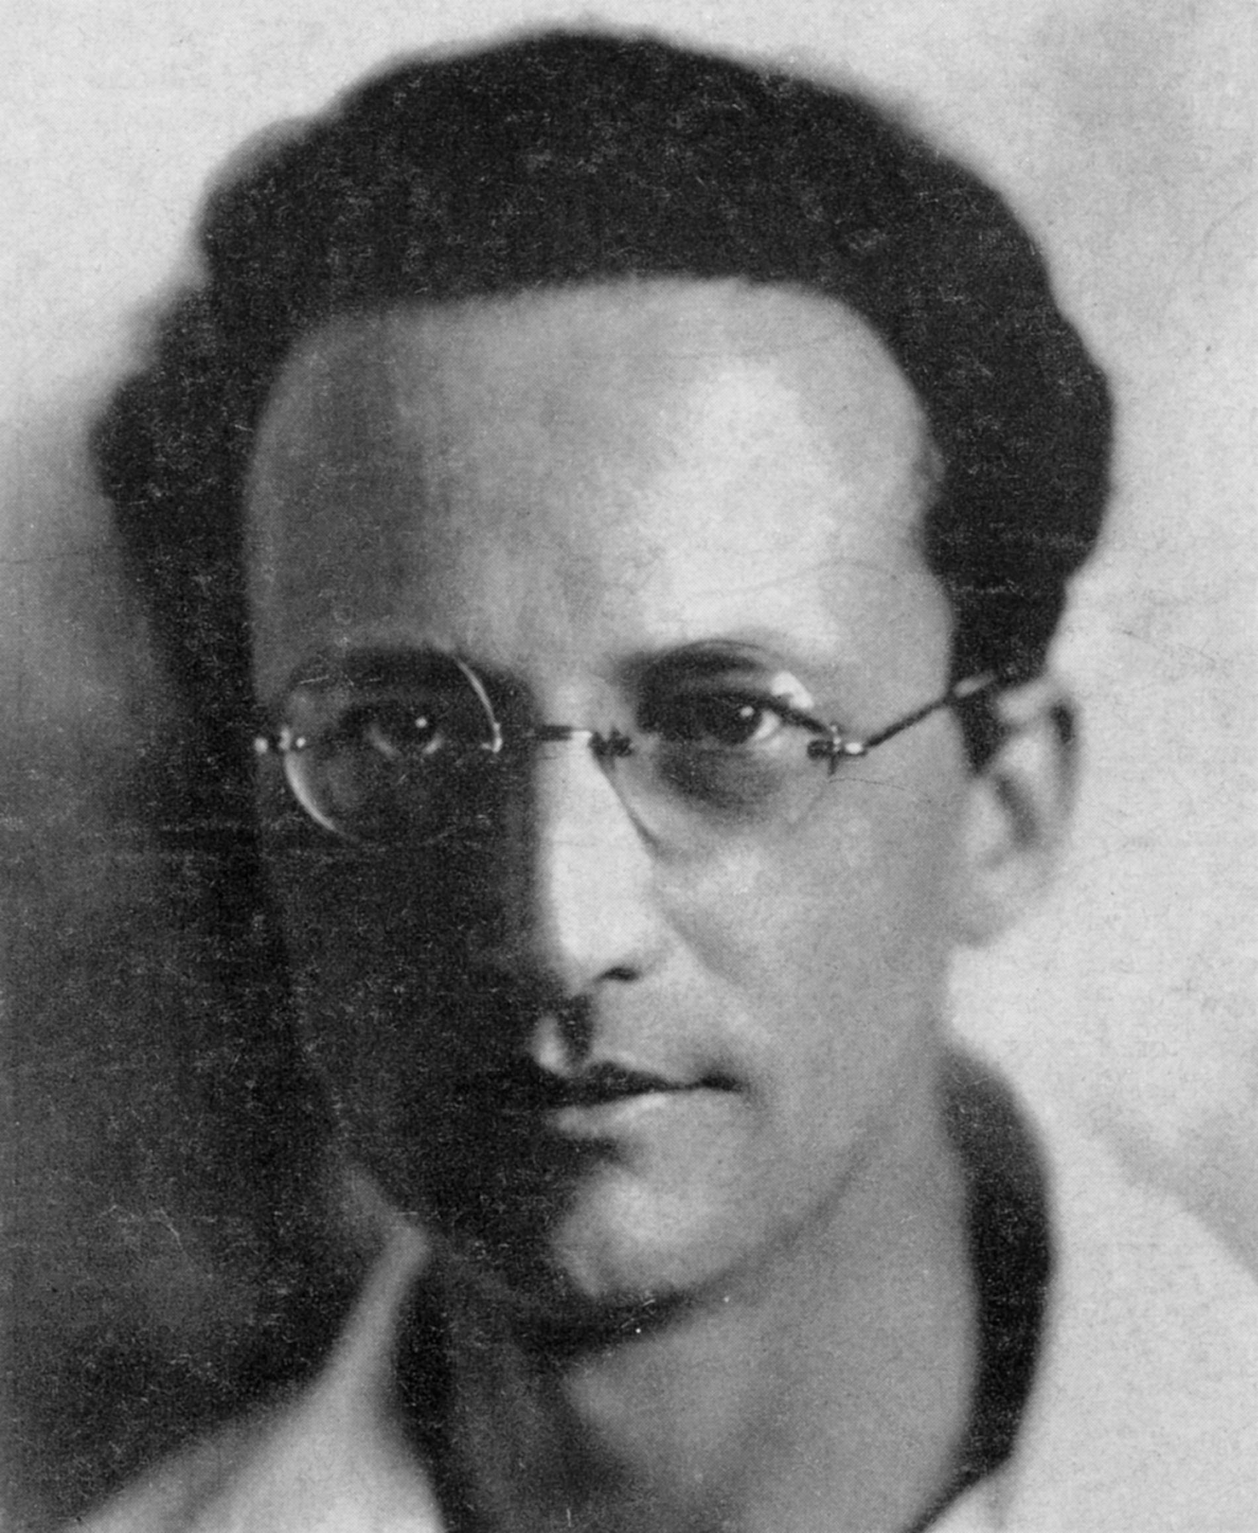
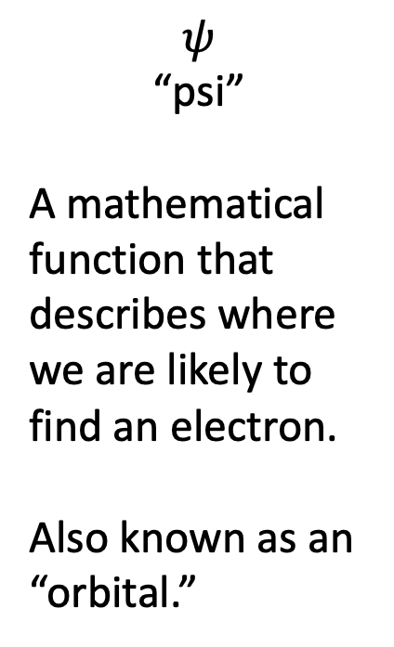
How do we even know any of this?
Erwin Schrödinger
Schrödinger’s equation
$$ψ$$
“psi”
A mathematical function that describes where we are likely to find an electron.
Also known as an “orbital.”

Slide 3
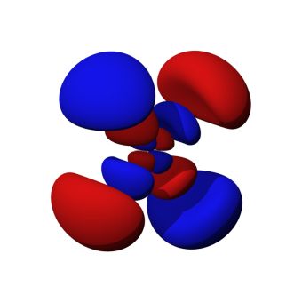
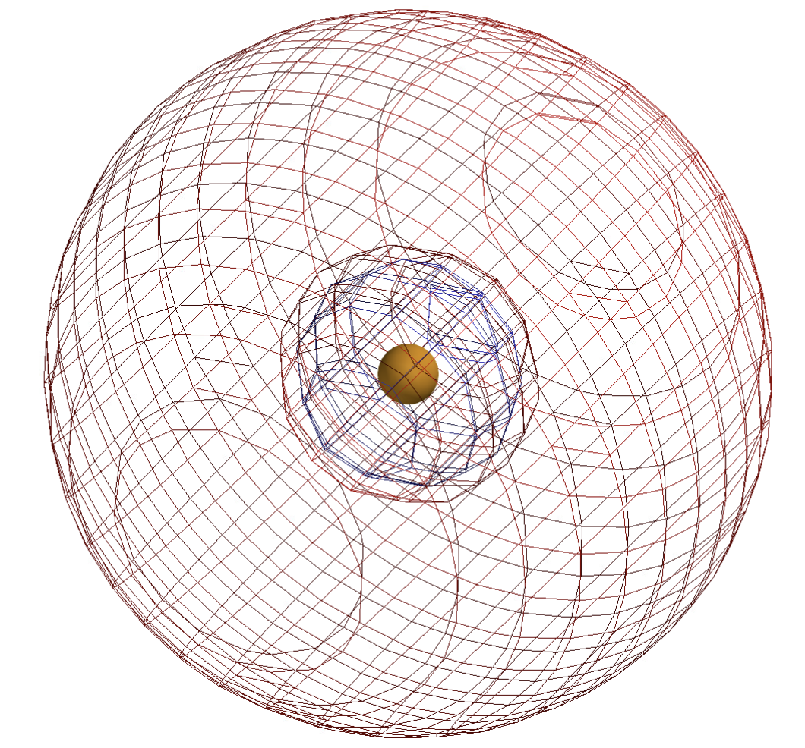
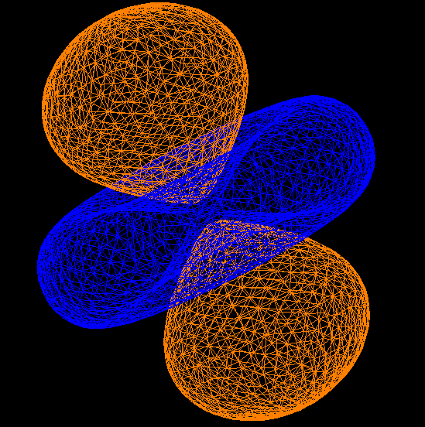
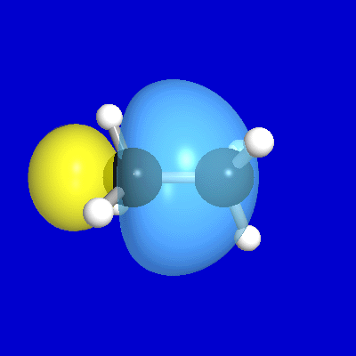
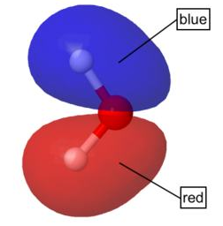
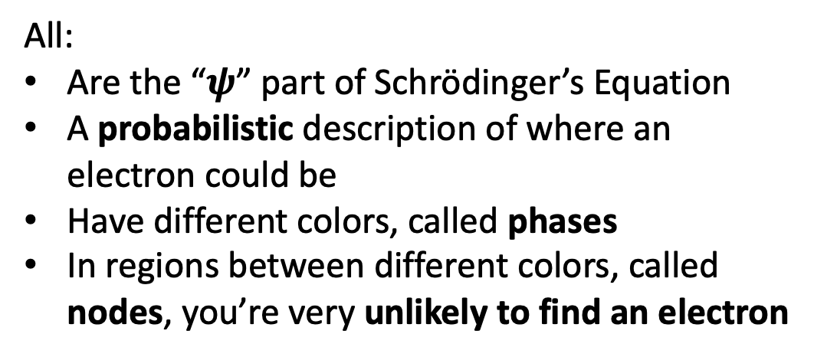
The many ways of depicting orbitals
Atomic orbitals
All:
Are the “$ψ$” part of Schrödinger’s Equation
A probabilistic description of where an electron could be
Have different colors, called phases
In regions between different colors, called nodes, you’re very unlikely to find an electron
Molecular orbitals

Slide 4

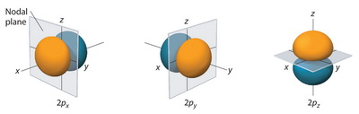
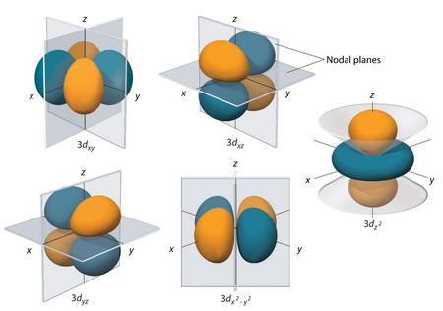
Planar and cone-shaped nodes

Slide 5
Radial nodes
What’s the shape of this node?

Slide 6
Radial nodes
What’s the shape of this node?
The phase (color) change in the middle reveals a round node called a radial node

Slide 7
Electrons go through nodes
Ironically, although you won’t find an electron at a node, it tells you something: electrons are passing perpendicularly through those nodes!
e⁻
node

Slide 8
Electrons go through nodes
This one?

Slide 9
Electrons go through nodes
This one?

Slide 10
Electrons go through nodes
This one?

Slide 11
Electrons go through nodes
This one?

Slide 12
Electrons go through nodes
This one?

Slide 13
Electrons go through nodes
This one?

Slide 14
Electrons go through nodes
This one?

Slide 15
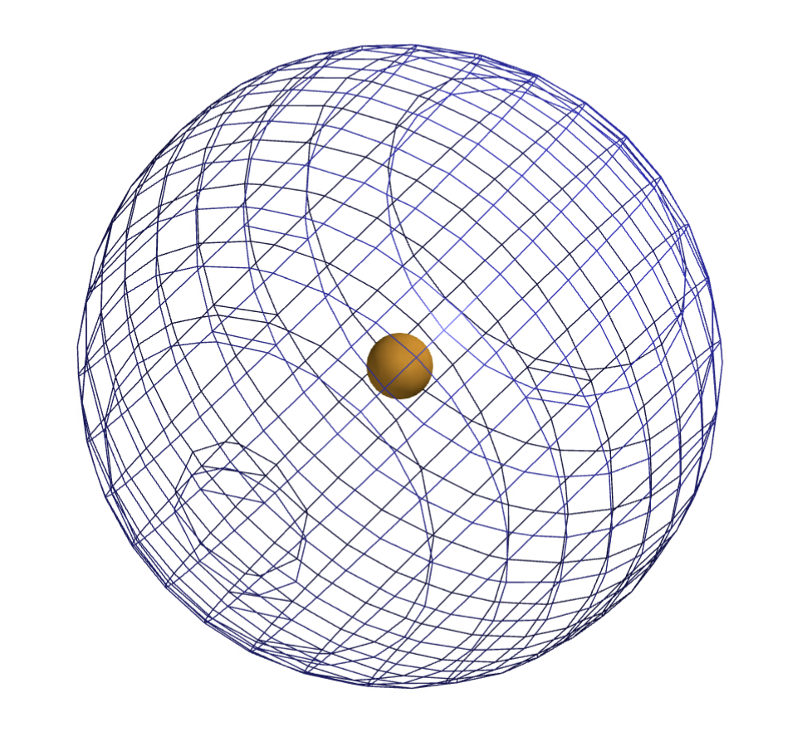
Electrons go through nodes
S-orbital in the 1st shell
This orbital doesn’t have any nodes => not much movement

Slide 16
Electrons go through nodes
S-orbital in the 2nd shell
Radial nodes imply electrons “breathing” (moving in and out)

Slide 17
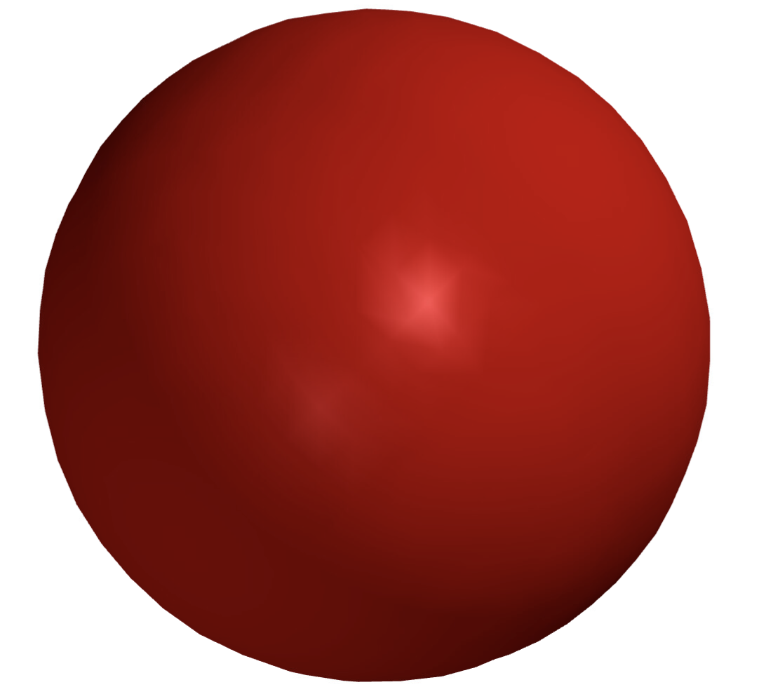
When depicted in solid mode, we can’t see radial nodes

Slide 18
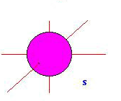
Orbitals & the 1st shell
1st shell has only one orbital (called an s-orbital)
s orbital with one electron

Slide 19
Orbitals & the 1st shell
1st shell has only one orbital (called an s-orbital)
s orbital with two electons

Slide 20
Orbitals & the 1st shell
1st shell has only one orbital (called an s-orbital)
s orbital with two electons
Note: Helium “has” a second shell (and a third shell …) There aren’t any electrons in them, but you can still “see” them … in Spartan!

Slide 21
1st and 2nd shells of Helium
s-orbital comprising the 1st shell, containing two electrons
Spartan labels this HOMO (for Highest Occupied Molecular Orbital)
Empty s-orbital in the 2nd shell
Spartan labels this LUMO (for Lowest Unoccupied Molecular Orbital)

